Slide 1
[MSCA 31008 Data Mining] Predicting Startup Success
Aman Gupta, Nuka Gvilia, Michelle Tang, Ryan Nathenson

Slide 2
AGENDA
1
2
3
4
5
BACKGROUND AND BUSINESS USE CASE
DATA SOURCES
EDA
MODELING
RESULTS AND NEXT STEPS
2

Slide 3
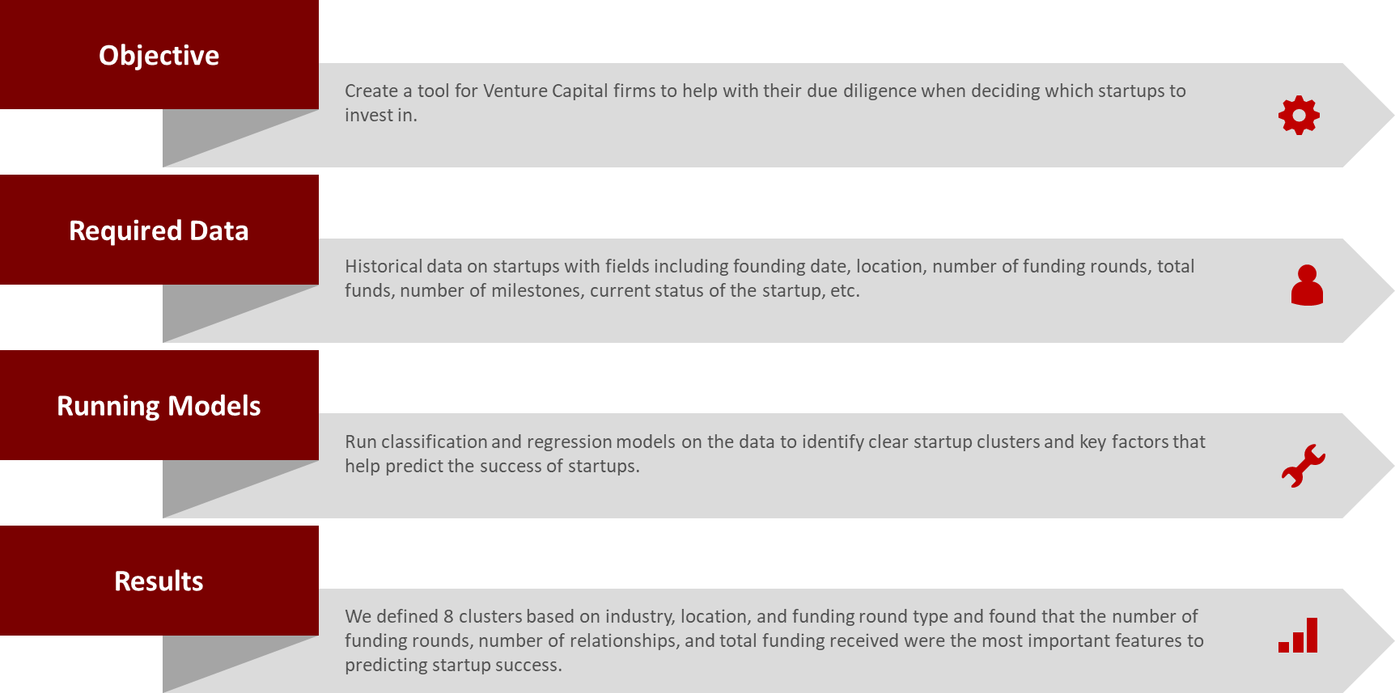
EXECUTIVE SUMMARY
3
Notes:
Ryan

Slide 4
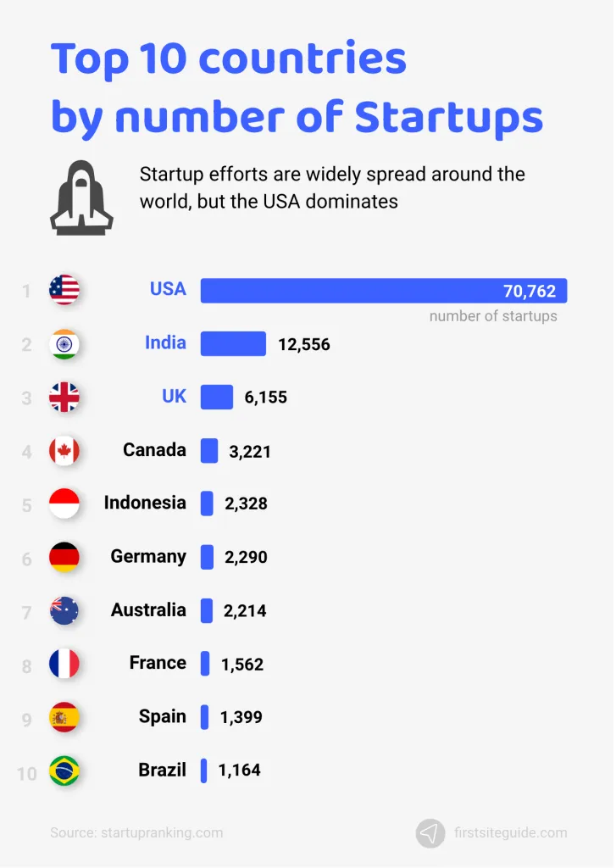
BACKGROUND AND BUSINESS USE CASE
Background
Over 100K active startups in the world
Roughly 90% of startups fail
10% failing within the first year
70% failing during years two through five
Business Use Case
Provide a tool for investors to predict whether a startup will succeed or fail
Identify key factors that predict startup success
Cluster startups in order to relate them to similar companies
4
Notes:
Ryan
Venture Capitalists invested over $675 billion in startups worldwide in 2021
1% of startups evolve into a “unicorn” (valued > $1B)

Slide 5
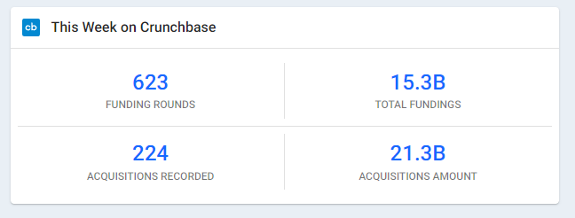
DATA SOURCES
Kaggle - Startup Investments
Crunchbase
“Founded to be the master record of data on the world’s most innovative companies”
Open database of businesses
Used by over 4K venture capital firms
5
Notes:
Ryan

Slide 6
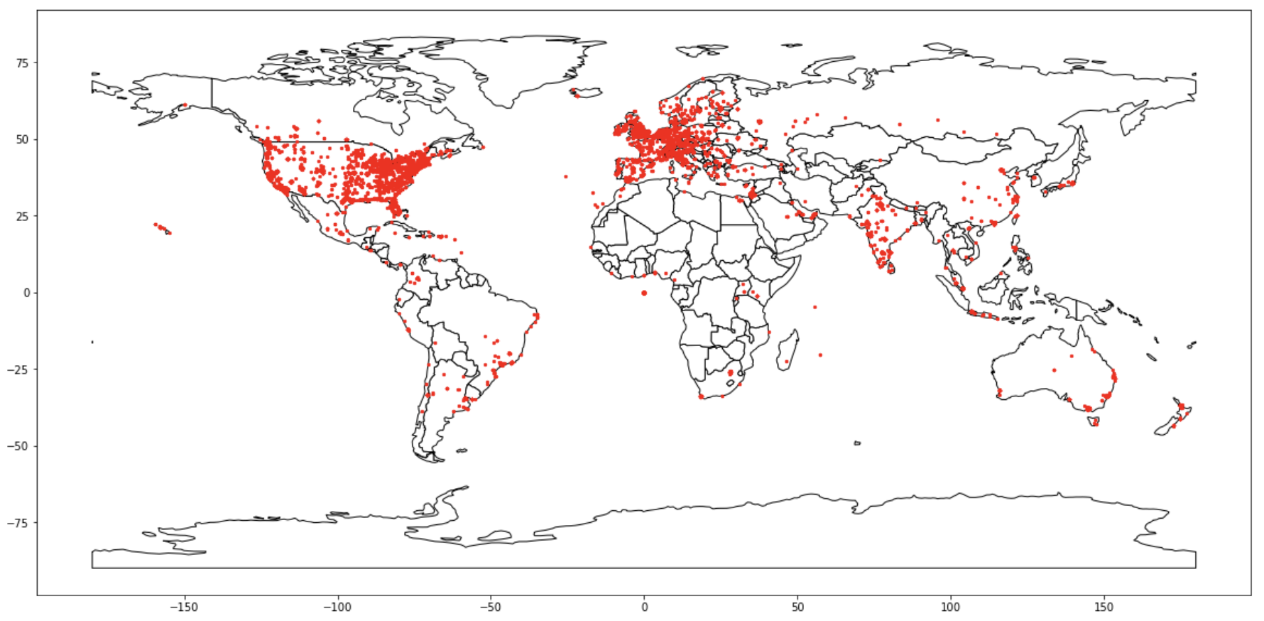
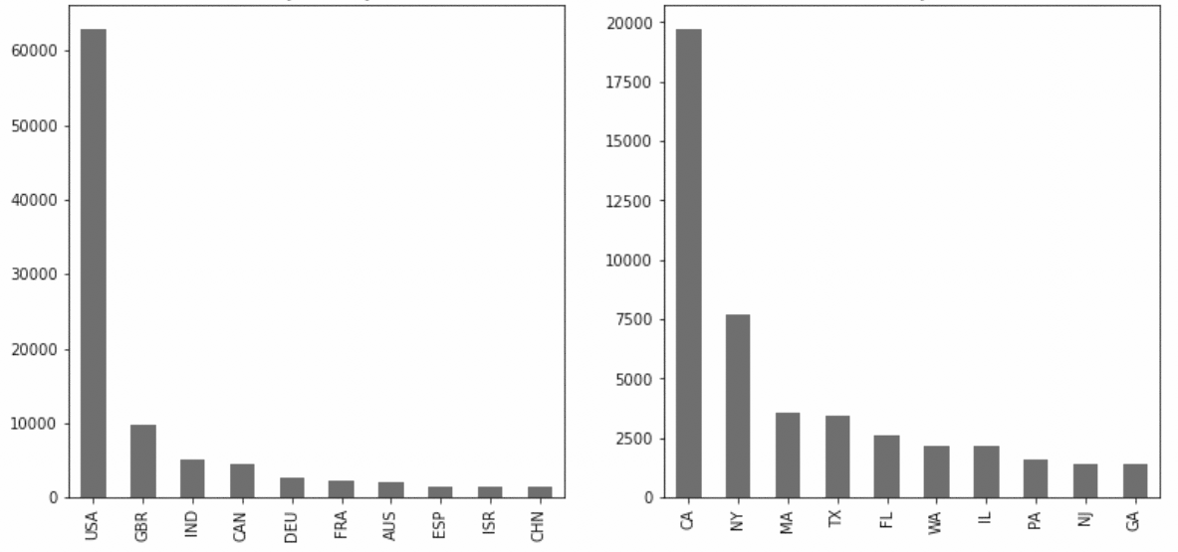
EDA
Startups by Country
Startups by State
6
Notes:
Nuka

Slide 7
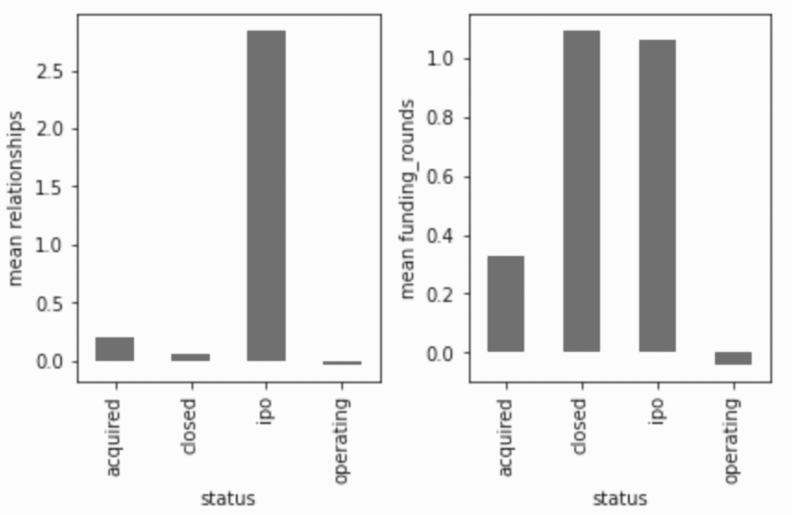
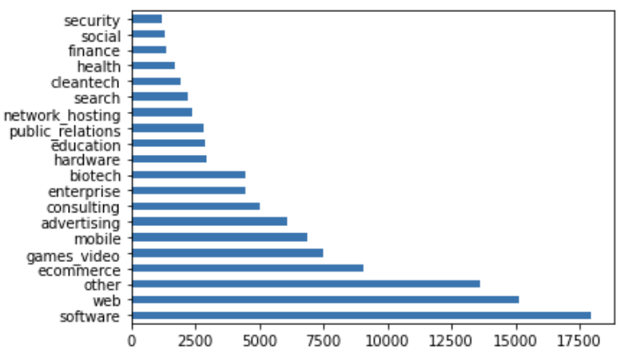
EDA
Mean Relationships by Status
Funding Rounds by Status
Distribution of Startup Categories
7
Notes:
Nuka

Slide 8
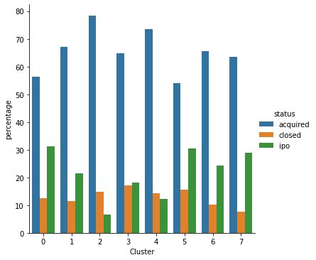
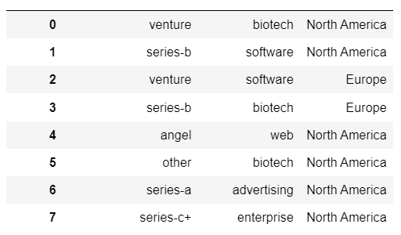
CLUSTERING
Cluster Membership - Worldwide
Cluster
Funding Round Type
Category
Region
8
Notes:
Nuka/Michelle

Slide 9
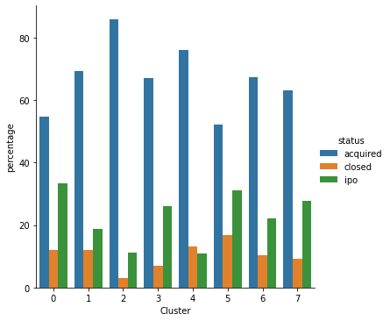
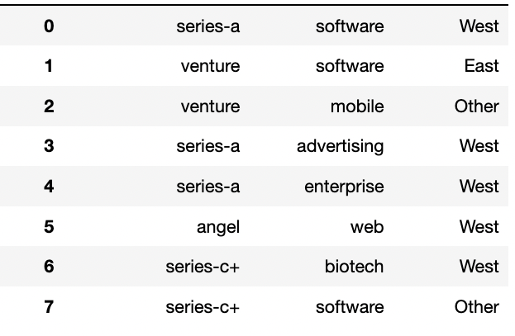
CLUSTERING
Cluster Membership - USA
Cluster
Funding Round Type
Category
Region
9
Notes:
Michelle

Slide 10
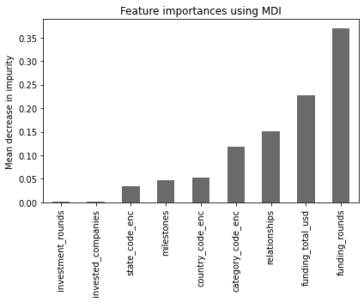
MODELS USED FOR STARTUP SUCCESS PREDICTION
Models Deployed | Accuracy | Explainability | Ability to generalize
Logistic Regression (Baseline model) | 0.80
Logistic Regression (with SMOTE) | 0.84
Logistic Regression (GridSearchCV) | 0.85
Random Forest Classifier | 0.96
Bagging Classifier | 0.87
ADABoost Classifier | 0.91
Voting Classifier | 0.94
10
Notes:
Aman

Slide 11
NEXT STEPS
Work with Crunchbase to set up a live pull from their API
Add more variables to clustering analysis by doing in depth feature engineering using additional data sets
Perform forward/backward selection on features to fine tune models further
11
Notes:
Aman

Slide 12
QUESTIONS?

